Slide 1
Chapter 1

Slide 2
NLP and its application
NLP is the set of methods for making human language accessible to computers.
NLP is focused on the design and analysis of computational algorithms and representations for processing natural human language.
Application examples : Automatic machine translation , spam/non-spam email classification, dialog systems ,extracting information from texts, translating between languages, answering questions, holding a conversation, taking instructions …

Slide 3
Themes and perspectives in NLP :
Learning and knowledge
Search and learning
Relational, compositional and distributional perspectives

Slide 4
NLP - Learning and Knowledge Perspective:
Combination of knowledge and Machine Learning in NLP
Using ML to…
Train end-to-end systems that transmute raw text into output structure like a summary, database, or translation.
Provide compositional Sentence organization → ex: meaning of larger units gradually constructed from the meaning of their smaller constituents.
Using ML for…
Transforming text into a stack of general-purpose linguistic structures:
From subword units called morphemes:
to word-level parts-of-speech
to tree-structured representations of grammar
to logic-based representations of meaning.
Supervised ML systems can…
make use of features or methods like stemming, parsing, part-of-speech tagging

Slide 5
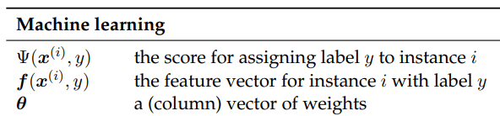

Search and Learning Perspective
Much of the work of NLP → the design of the model Ψ
Looking at NLP problems from mathematical point of view, with two distinct modules as Search and Learning.
Search module : This module finds the output yˆ that gets the best score with respect to the input x. Because the outputs are usually discrete in NLP problems, it relies on combinatorial optimization.
Learning module : This module is responsible for finding the parameters θ. Because the parameters are usually continuous, learning algorithms generally rely on numerical optimization.

Slide 6
Relational & Compositional Perspective
The relational, compositional, and distributional perspectives all contribute to our understanding of linguistic meaning.
The Relational perspective on meaning is the basis for semantic ontologies such as WORDNET → the relations that hold between words and other elementary semantic units.
Compositional perspective : The meaning of a word is constructed from the constituent parts (journalists → journalist, journal → jour). This principle can be applied to larger units: phrases, sentences, and beyond

